Slide 1
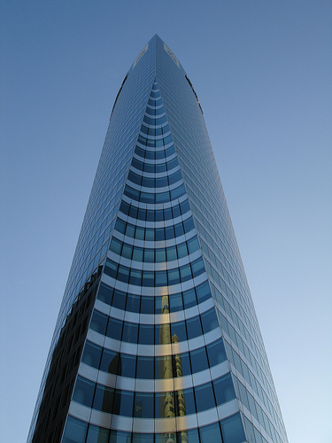
Bioclimatic Facades:
Responding to External Environmental
Conditions for the Heath and Safety of Occupants

Slide 2
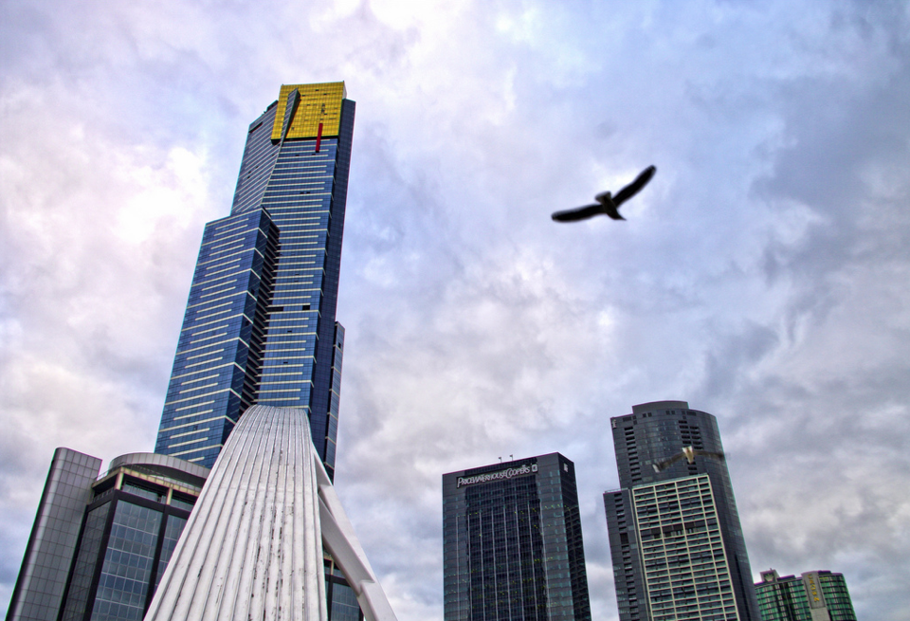

Somfy Systems is a Registered Provider with The American Institute of Architects
Continuing Education Systems. Credit earned on completion of this Program will be reported to CES Records for AIA members. Certificates of Completion for non-AIA members are available on request. This program is registered with the AIA/CES for continuing professional education. As such, it does not include content that may be deemed or construed to be an approval or endorsement by the AIA of any material of construction or any method or manner of handling, using, distributing, or dealing in any material or product. Questions related to specific materials, methods, and services will be addresses at the conclusion of this presentation.

Slide 3

Learning Objectives
Attendees will be able to:
Define solar control, Ecliptic Path, Solar Irradiance, and Luminance
Understand Bioclimatic Architecture
Discover how natural light and ventilation effect the health of a building’s occupants
Determine the benefits of automated shading

Slide 4
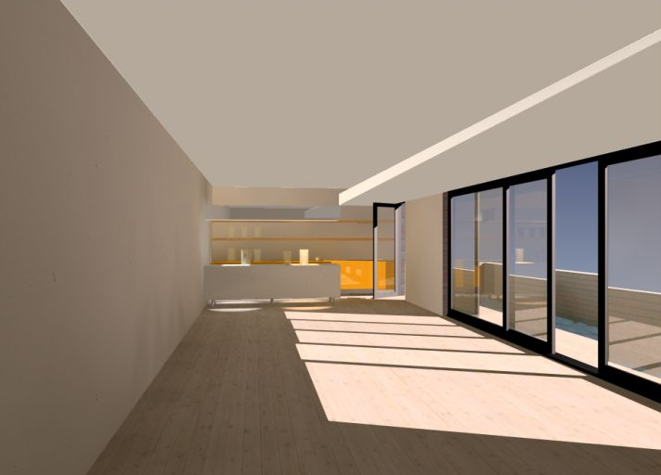
What is Solar Control?
The management of natural light
The term solar relates to the sun
Why solar control?
Notes:
Solar control is the careful balance of both controlling and managing natural light. The main idea is to maximize the amount the natural light that enters the space but control the harsh glare and heat gain that comes from the sun.

Slide 5



Why Solar Control?
Glare
Heat Gain
Sun
Notes:
The key objective is to maximize the use of natural daylight without the problems of glare or excessive solar heat gain

Slide 6
What is Solar Gain?
Heat is primarily transmitted through windows, which varies depending on the sun’s relative orientation to the wall it strikes.
Notes:
The sun can help heat buildings in winter by a greenhouse effect through glazed surfaces or by warming solid walls. Solar gain is not always useful because in summer it is preferable to be protected from it, and in certain types of buildings the heat produced internally is so great that additional solar heat gain can lead to overheating. Solar gain reaches us either as diffuse or direct. Applying the principles of bioclimatic facades assist with techniques to deal with the direct and diffuse heat gain. The graph to the left shows solar gain on a typical July day based upon time of day and the orientation of a vertical surface. The most intense heat gain occurs on the East facing surface in the morning from about 6am to 9am. Then again from about 3pm to 5pm, on the west facing surface. (Need to change the graph O to W)

Slide 7
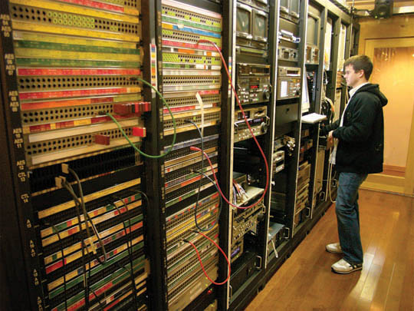
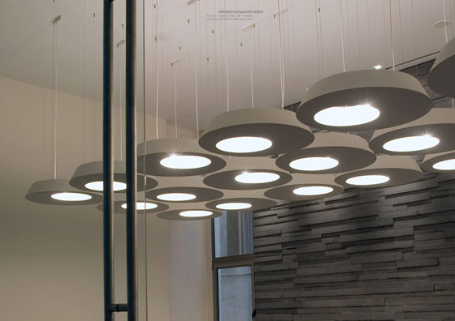

Equipment
What is Internal Heat Gain?
Lighting
Occupants
Notes:
Internal heat gains are caused by a number of sources in a building. Causes can be occupants, lighting, appliances, and equipment.
The presence of people is accompanied by heat and humidity being produced. This heat is continuously removed by convection (35%) radiation (35%) and evaporation (25%) depending upon people’s activities. The graph on the right shows the heat gain in a classroom over a 45 minute period. Over 45 minutes there is a gradual climb in temperature equallng about 7 degrees C, until it dissipates again once the room empties after 45 minutes.
The graph on the left shows how people in different activities, different lighting, and electrical equipment emanate heat and humidity into the environment. The left hand column shows the watts generated in heat, while the right hand column shows the humidity factor in grams of water per hour. The activities of the people in the building can significantly affect the heat gain. A person at rest generates on average 114 watts of heat, while someone physically working hard can generate 406 watts. The types of equipment in an environment are also a big factor. Rooms with ovens or laundry appliances will have a lot of heat generated by the equipment, while a room full of computers would generate less.

Slide 8
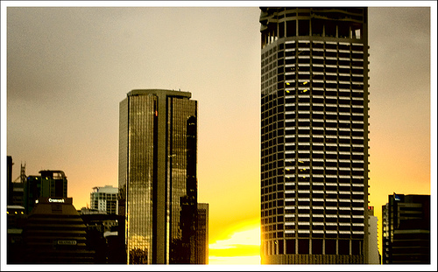
The Ecliptic Path, Solar Irradiance,
and Luminance
Notes:
The sun follows a path and every point of which is determined, in a given place, by its angular elevation and measurement . By knowing the time of year and the position of the building, we can precisely calculate the angle of elevation of the sun in the sky as well as the horizontal angle along the meridian plane known as the azimuth. Having this information enables us to create a Bioclimatic Façade that interacts with the sun’s light, warmth, and energy once we can define the hours of exposure and the angle of incidence.

Slide 9

What is the Ecliptic Path?
The sun’s path through the sky over the course of a year
Single day vs full year
Summer and winter solstice
Geographical location
Façade orientation

Slide 10
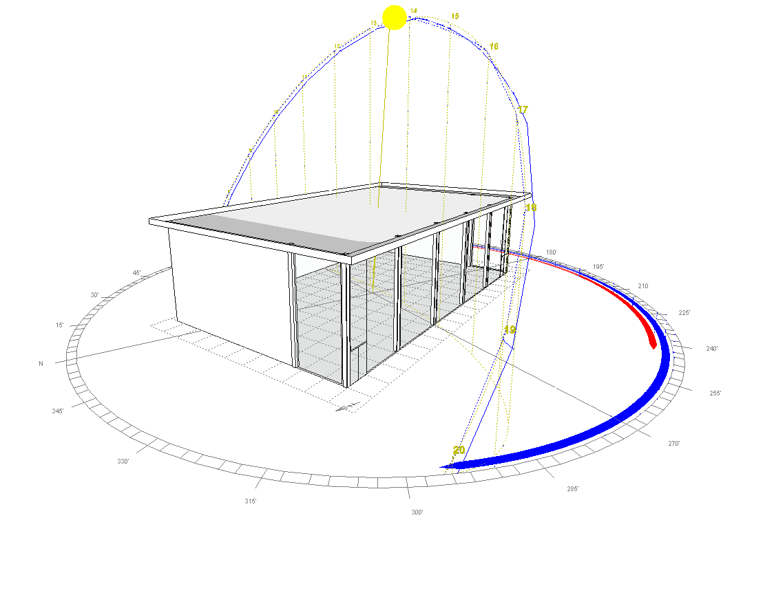
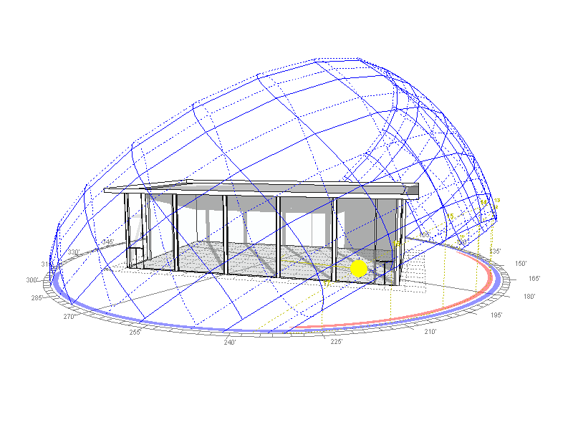
Single Day vs Full Year
Solar Movement – Single Day
Solar Movement – Full Year
Notes:
10
The diagrams show you the sun’s path (yellow line) through the sky in relation to a single day and a full year time.
10

Slide 11
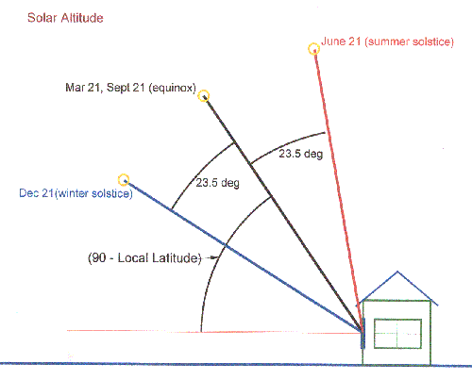
Summer and Winter Solstice
Notes:
The sun’s elevation is greatest at the summer solstice and lowest at the winter solstice.

Slide 12
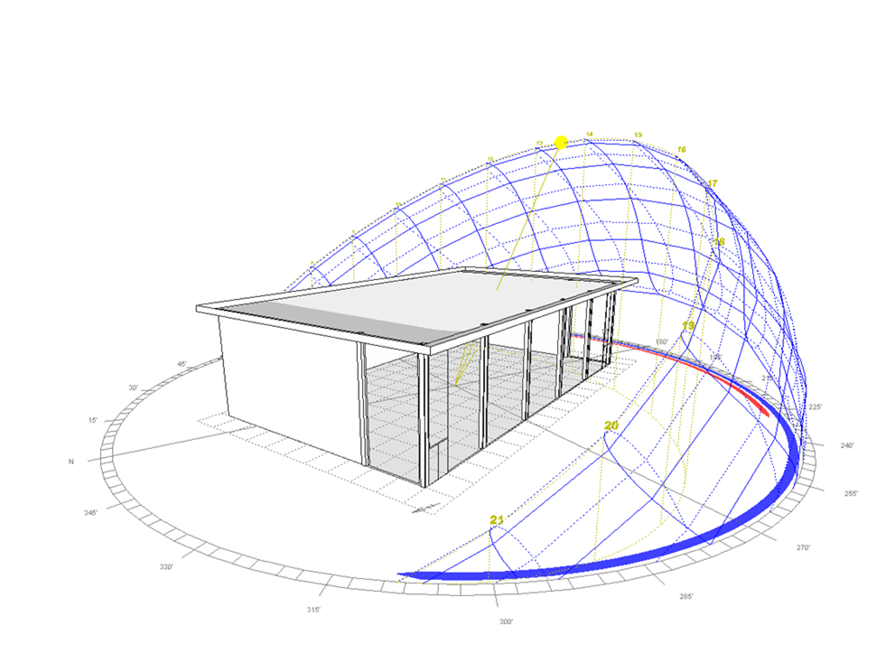
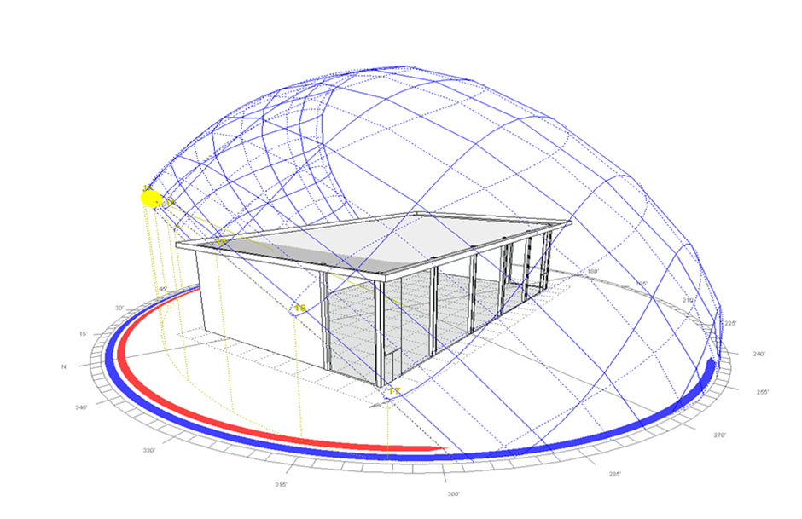
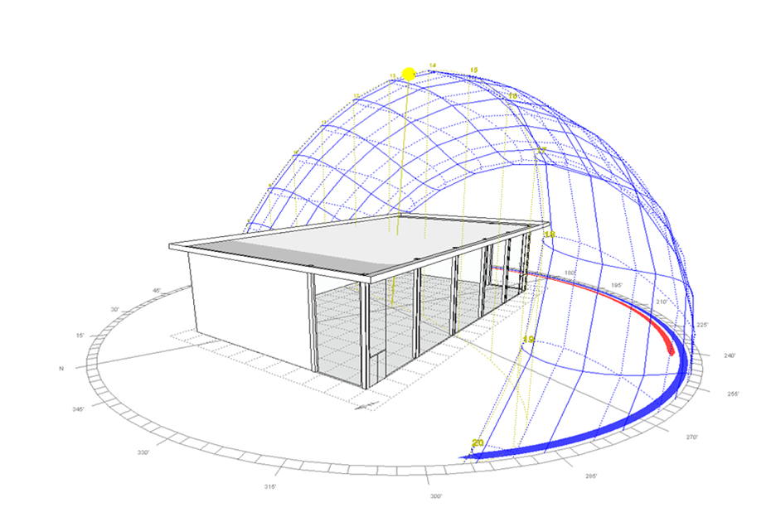
Geographic Location
Sydney
Calgary
Miami
Sydney
Calgary
Miami

Slide 13
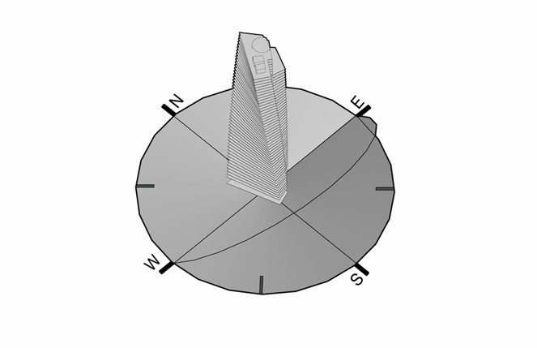
Facade Orientation
Notes:
The sun plays a role in providing light and heat to a building. Adapting the orientation to fit the building's needs thereby enables a reduction in the need for heating and lighting. The graph on the right illustrates the annual heating requirements of a building depending on the orientation and proportions of its windows (the ration of glazed surfaces to that of the whole façade). A perceptible reduction in heating needs with a southerly orientation.

Slide 14
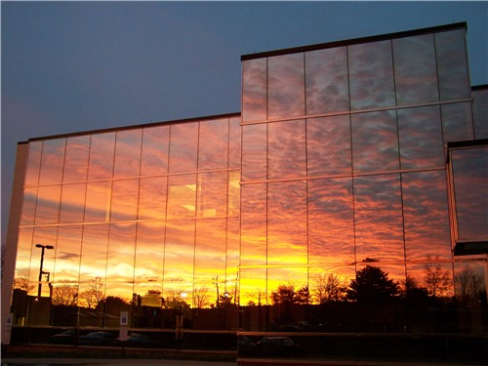
What is Solar Irradiance?
The amount of solar energy that arrives at a specific point and time
Three types

Slide 15
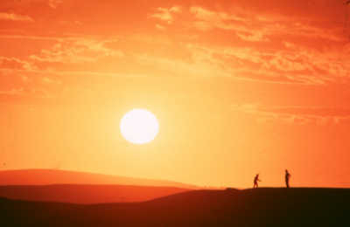
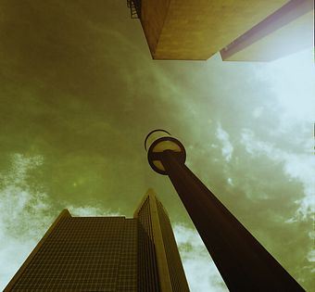
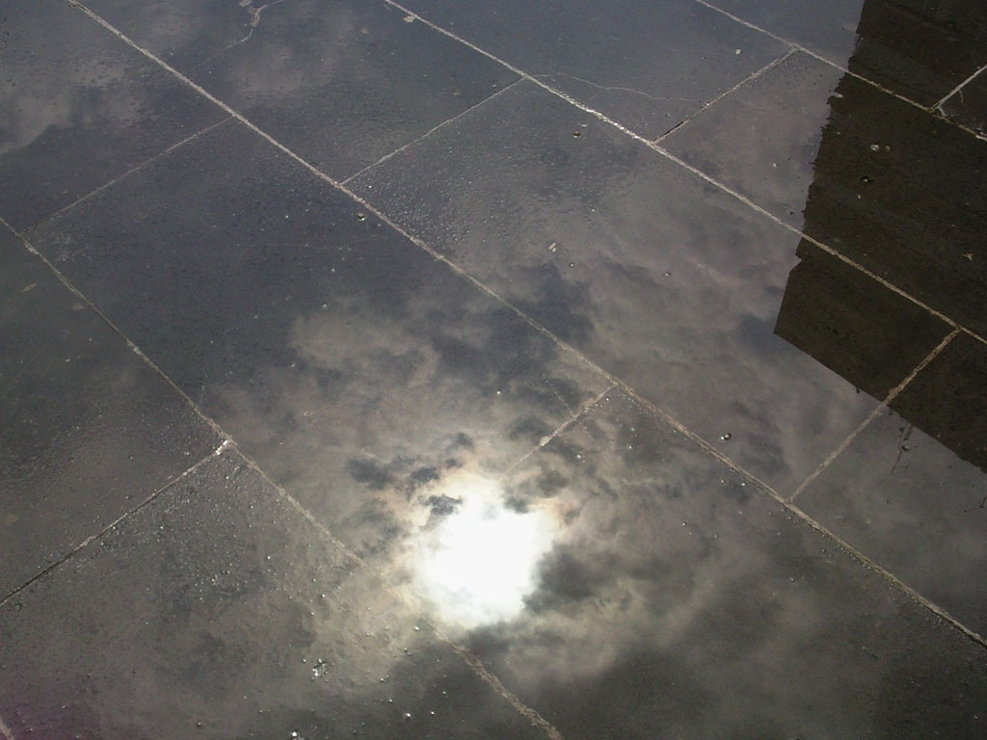
Direct Radiation
Diffused Radiation
Reflective Radiation

Slide 16
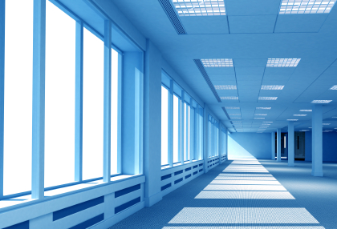
What is Luminance?
The measurement of the intensity
of light traveling in a given direction
Notes:
Daylight luminance is the light provided by the sky throughout the day. It intensifies based upon the time of year and whether you are in direct sunlight, under a clear sky, or under an overcast sky. This enables you to plan your building’s use of natural light accordingly on clear days and overcast days, and based upon which parts of the building will be in direct sunlight or under indirect daylight luminance

Slide 17
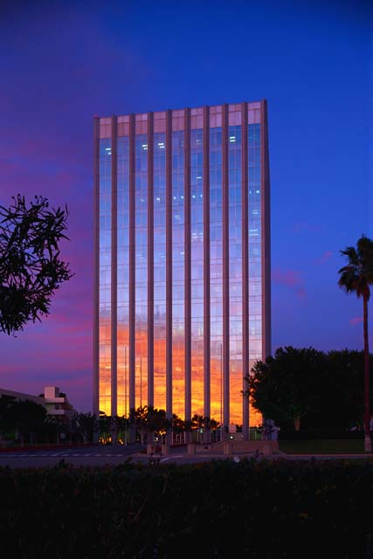
What is Bioclimatic Architecture?
Design based on using solar energy and local climate to provide thermal and visual comfort of the occupants.
Bioclimatic facades
Harnessing natural light
Thermal comfort
Visual comfort
Notes:
Building + Climate = Comfort of Occupant. The purpose of the design, renovation, and construction of a building is to create optimal harmony with its surroundings, and thereby to give climate its rightful place among the basic factors used by architects whenever they modify the environment. Architecture that includes climate and its implicit dynamics is bioclimatic architecture.

Slide 18
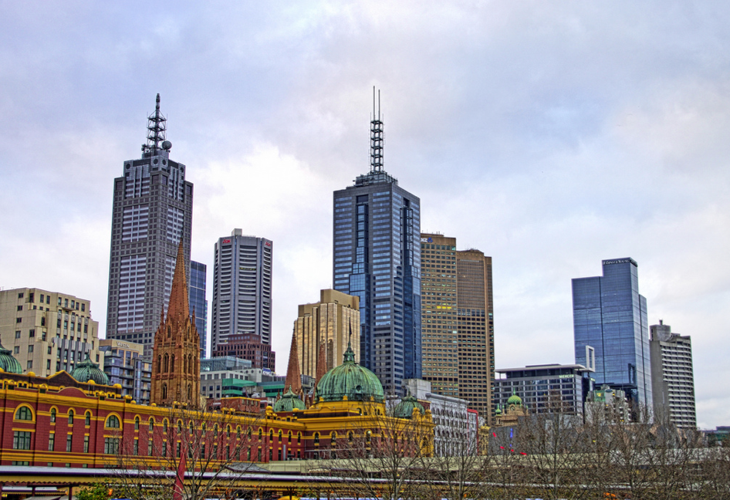
Bioclimatic Facades
Location, location, location…
Notes:
Buildings provide a shield from solar radiation and wind, store heat and increase the temperature outside. Paradoxically, they can also create winds or reflect the sun’s rays.

Slide 19
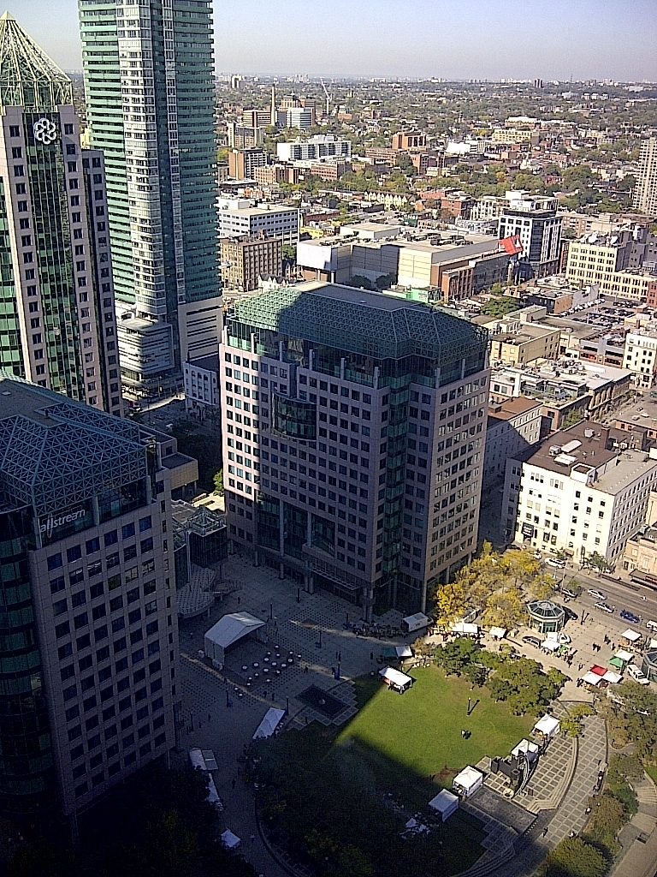
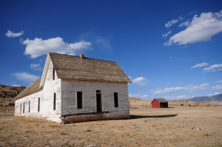
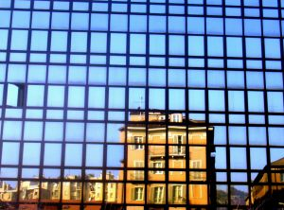
Shaded
Full Exposure
Glare
Notes:
Understanding the immediate surroundings will influence the creation of the Bioclimatic Façade. Tall neighboring buildings may mask the sun during certain times of the day or year. Conversely, a highly reflective neighboring building may create the need to mitigate glare in areas where their orientation with the horizon normally would not make glare a factor.

Slide 20
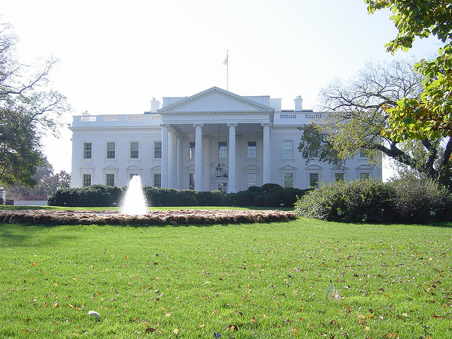

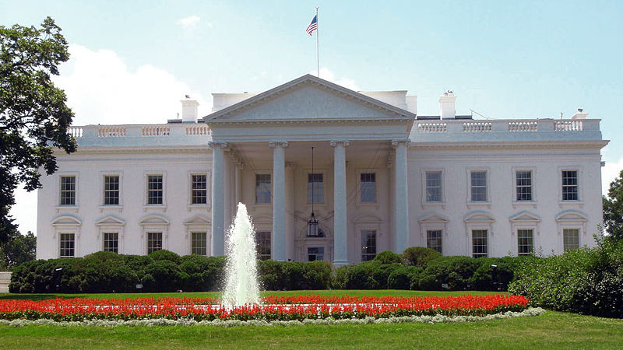
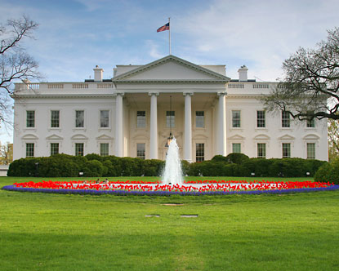
Fall
Time of Year
Winter
Spring
Summer

Slide 21
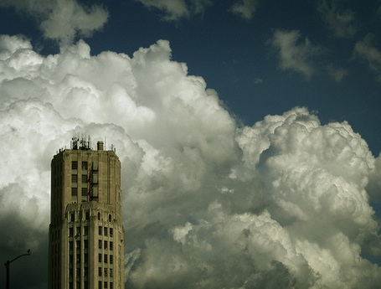
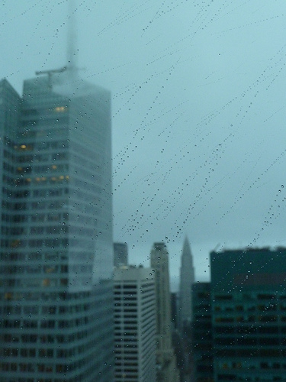
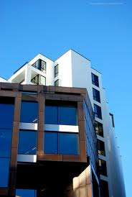
Sky and Solar Conditions
Notes:
This enables you to plan your building’s use of natural light accordingly on clear days and overcast days, and based upon which parts of the building will be in direct sunlight or under indirect daylight luminance.
21

Slide 22
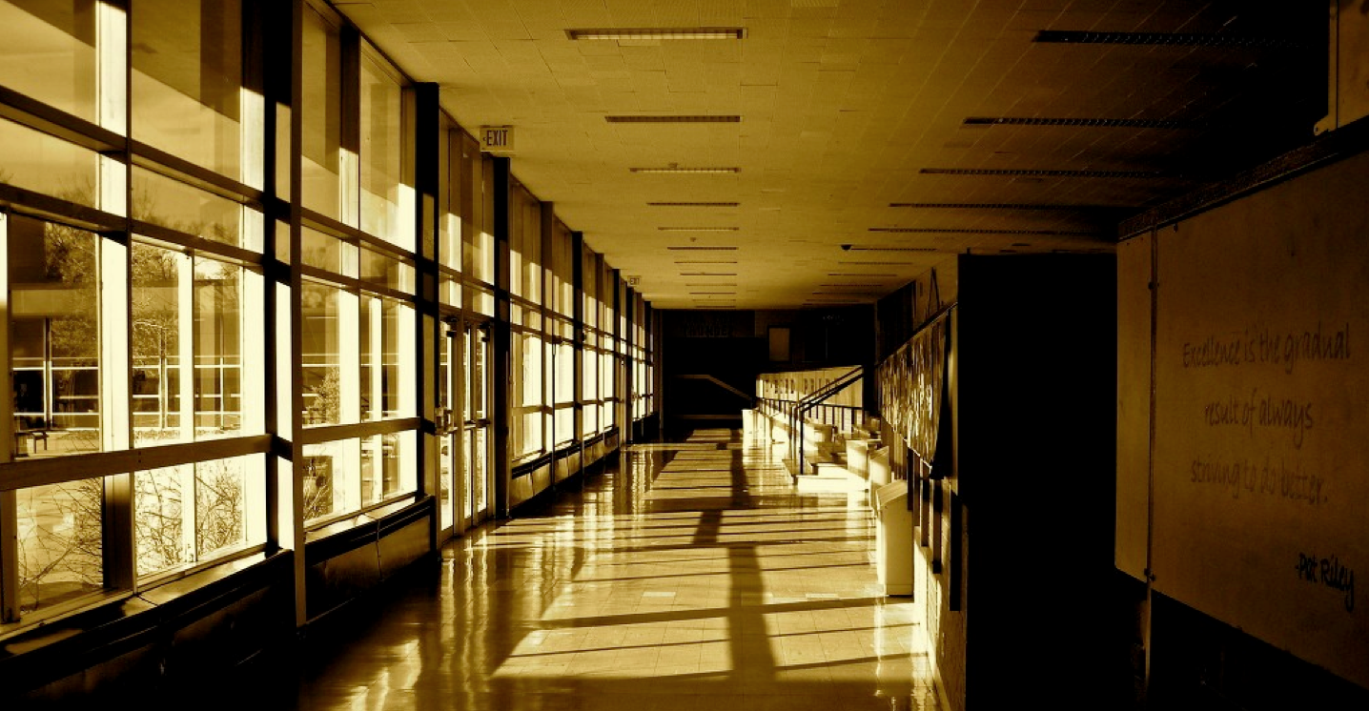
What is Natural Day Lighting?
Day lighting is the controlled admission of natural light, whether direct or diffused sunlight, into a building to reduce electric lighting and increase energy savings.
Notes:
Natural lighting is preferable to artificial lighting because of its variability and its different tones. The variability of natural light enables the creation of harmony with the world outside and creates a warmer atmosphere inside. Spectral properties of natural light ensure the best possible visibility of objects and colors as seen in the graph on the right. Comparing the spectral distribution of natural light with the sensitivity of the eye, it shows that the human eye is naturally adjusted for natural light. Therefore maximizing the natural light in a space is optimal for our perception.
Artificial lighting reduces color rendering and should be considered a complement to natural light and harmonized as far much as possible with an appropriate control system.

Slide 23

Harnessing Natural Light
Solar Energy
Thermal Comfort
Visual Comfort

Slide 24
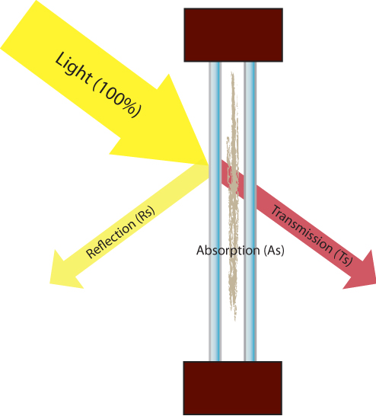
Solar Energy
Solar Energy and Heat Gain
As = solar absorption
Rs = solar reflection
Ts = solar transmission
As + Rs + Ts = 100%
Notes:
Solar energy is either Absorbed (As), Reflected (Rs), or Transmitted (Ts), no energy is lost. Lighter colors have higher reflection and lower absorption, darker colors the reverse. The energy ratios are different but the total energy is still either absorbs, reflected, or transmitted.

Slide 25
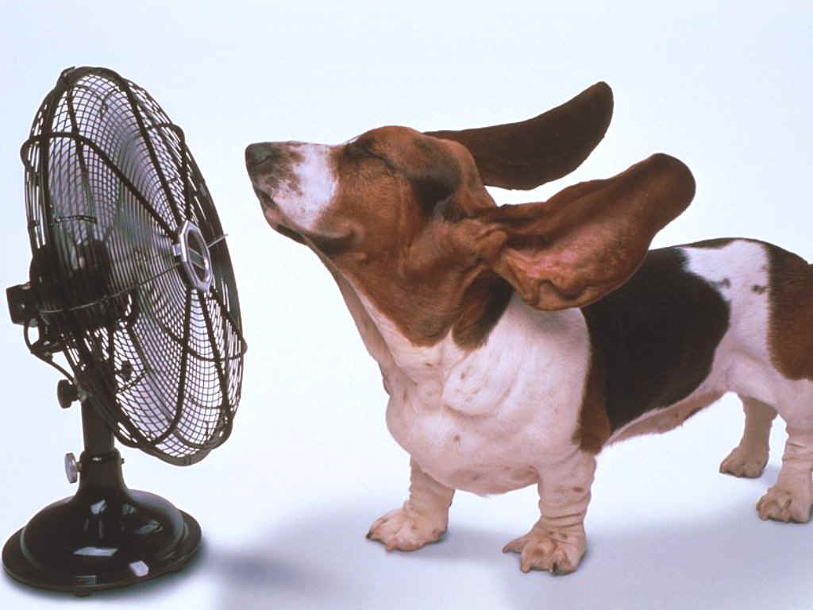
Thermal Comfort
Heating Strategy
Cooling Strategy
Health Benefits

Slide 26
Heating Strategy
Notes:
In a colder climate, the strategy is to capture as much as the heat and solar energy as possible. Heat capture is affected by glazing, daily and seasonal variations. Keeping shading devices open allows maximum heating from solar energy, while still available for use to minimize uncomfortable glare when needed.
Heat inside the building is enhanced by good insulation allowing for storage in the building’s structure. Heat can be retained based on the shape and air-tightness of the building’s skin together with the insulation properties of the walls. Dynamic insulation adds to heat retention when shading devices are lowered to give the heat an additional barrier to the outer skin of the building. Air flow and ventilation assist in t distribution of the heat retained inside.

Slide 27
Cooling Strategy
Notes:
Using shading on the apertures of a building mitigate heat gain by eliminating the full force of the direct sunlight. For mitigation of heat gain, shading is more effective when they are installed externally, so the solar energy is blocked or reflected before penetrating the building envelope.
Minimizing internal heat sources also assists in the cooling strategy. The diffusion of natural light into a space through solar shading can perform the dual task of minimizig heat from direct sunlight while simultaneously diffusing the natural light into a space, enabling the artificial lighting to be dimmed and eliminating a portion of the heat produced.
Excess heat can be dissipated through natural ventilation by using outlets where temperature differences create a “chimney” effect. Wind pressure and channeling air flows can be useful in expelling hot air from a building.

Slide 28

Benefits of Thermal Comfort *
Increases productivity
Improves performance of office tasks
-Low temperatures decrease dexterity
-High temperature reduce activity
Reduces the prevalence of Sick
Building Syndrome
Increases overall happiness of building
occupants
* Federation of European Heating, Ventilation, and Air Conditioning Association (REHVA) Guidebook 2010

Slide 29

80%
of operating cost are related to employees
increasing productivity by 1%
will off set energy costs for a year.
REHVA Guidebook 2010

Slide 30
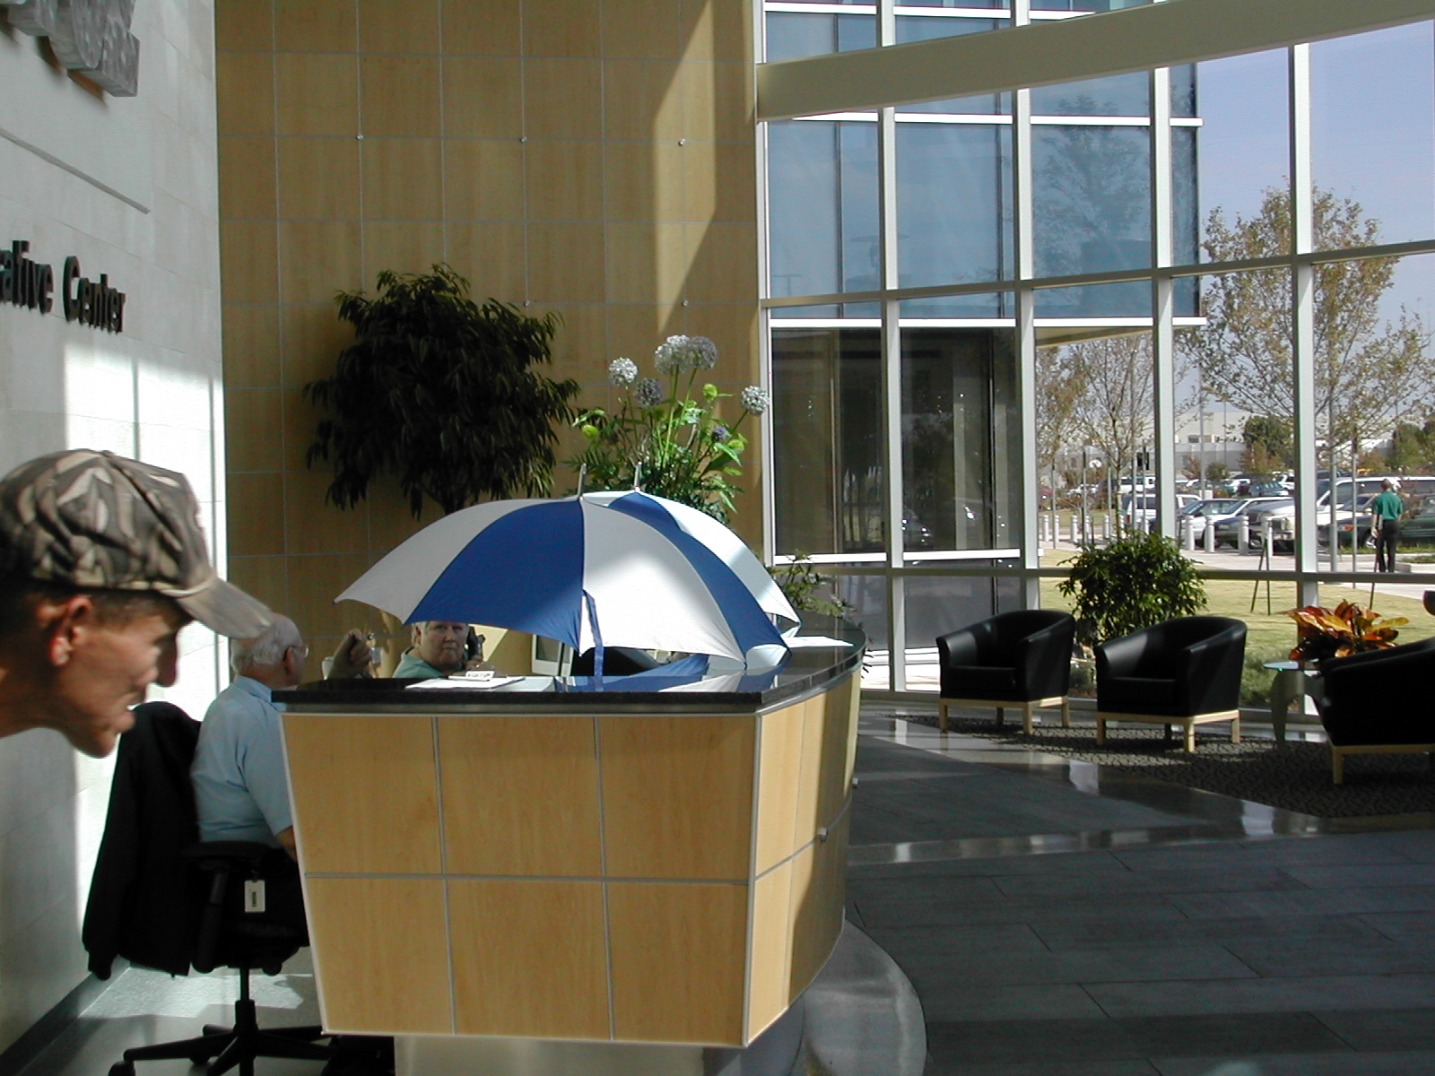
Got Shades?

Slide 31

Visual Comfort
Light Transmission
Daylight Factor
Light Balancing
Glare Reduction
Why Control Natural Light?
Benefits

Slide 32
Light Transmission
Notes:
Light transmission is the percentage of light transmitted through a glazed panel into a room. The higher the LT, the greater the amount of light entering the building, and the less electric lighting you will need during the day.
There are three approaches to the windows, and in each case, the light reacts differently. In all cases, some portion of the light is transmitted through the glass, some is absorbed, and some is reflected. The choice of LT factor is dependent on the level of light desired within a building. The natural light level outdoors ranges from 5000 lux on an overcast day to about 10,000 lux on a clear summer day. A LT factor of .5 would have a minimal impact in the scenario of an overcast day, but could hugely impact the light gaining entrance into a building on a clear summer day, reducing the visual discomfort.

Slide 33
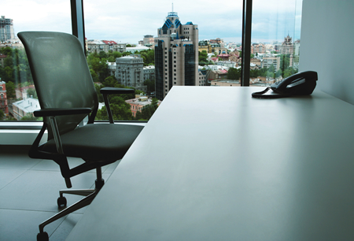
Daylight Factors
Assess the internal natural lighting levels in order to determine if they will be sufficient for the occupants to carry out their normal duties.

Slide 34
Light Balancing
Notes:
Good light balancing should guarantee visual performance that allows occupants of a building can conduct their activities as effectively as possible, while ensuring visual comfort through the absence of glare. The desired level of visual performance is determined by the required level of illumination of the work surface, and the contrast in illuminance between the object viewed and it s background. Visual discomfort is linked to glare in the field of vision.

Slide 35
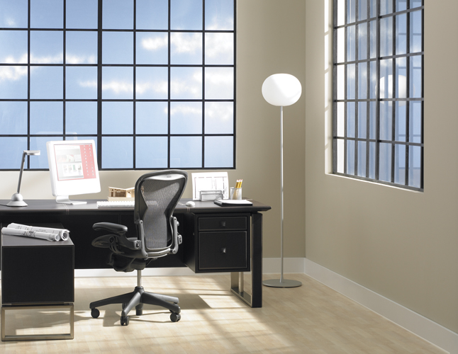
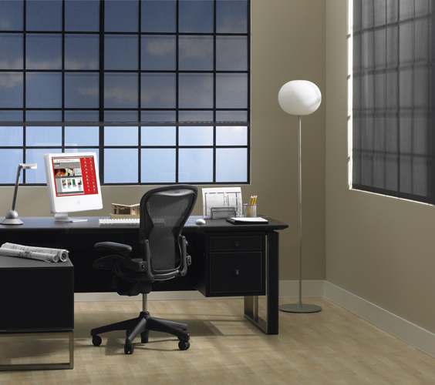
Glare Reduction
Without shades
With automated shades

Slide 36


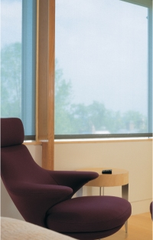
Why Control Natural Light?
Comfort
Aesthetics
Privacy
Energy Savings
UV Protection
Health
Safety

Slide 37

Benefits of Visual Comfort *
Increased worker productivity (3.75% CMU 2004)
Major health complaints are 20 to 25% less for persons close to exterior windows.
Access to windows and daylight resulted in 15% less absenteeism
Office workers perform 10 to 25% better on tests of mental function and memory recall
Glare is associated with negative performance
* REHVA Guidebook 2010

Slide 38

Adequate natural daylight in classrooms showed a
20%-25%
increase in learning rate.
REHVA Guidebook 2010

Slide 39
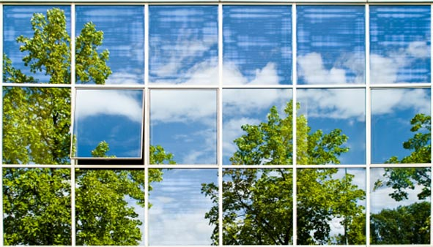
Windows
Highly Glazed Facades
Pros & Cons of Glazing
Natural Ventilation
Types of Ventilation
Benefits of Fresh Air
Notes:
Windows are vital to any building determining the parts of the landscape that become visible from inside, the thermal properties, light transmittance, solar factor, and their part in ventilation.
The figure on the left shows the quality criteria that enable the choice of window components to be determined and identifies the factors that reduce solar gains. IN terms of possible reduction of solar gains, the table on the right of that graph show the ranges of reduction that can be utilized through options for window shades, frames, shadows, curtains, glazing, and cleanliness.

Slide 40
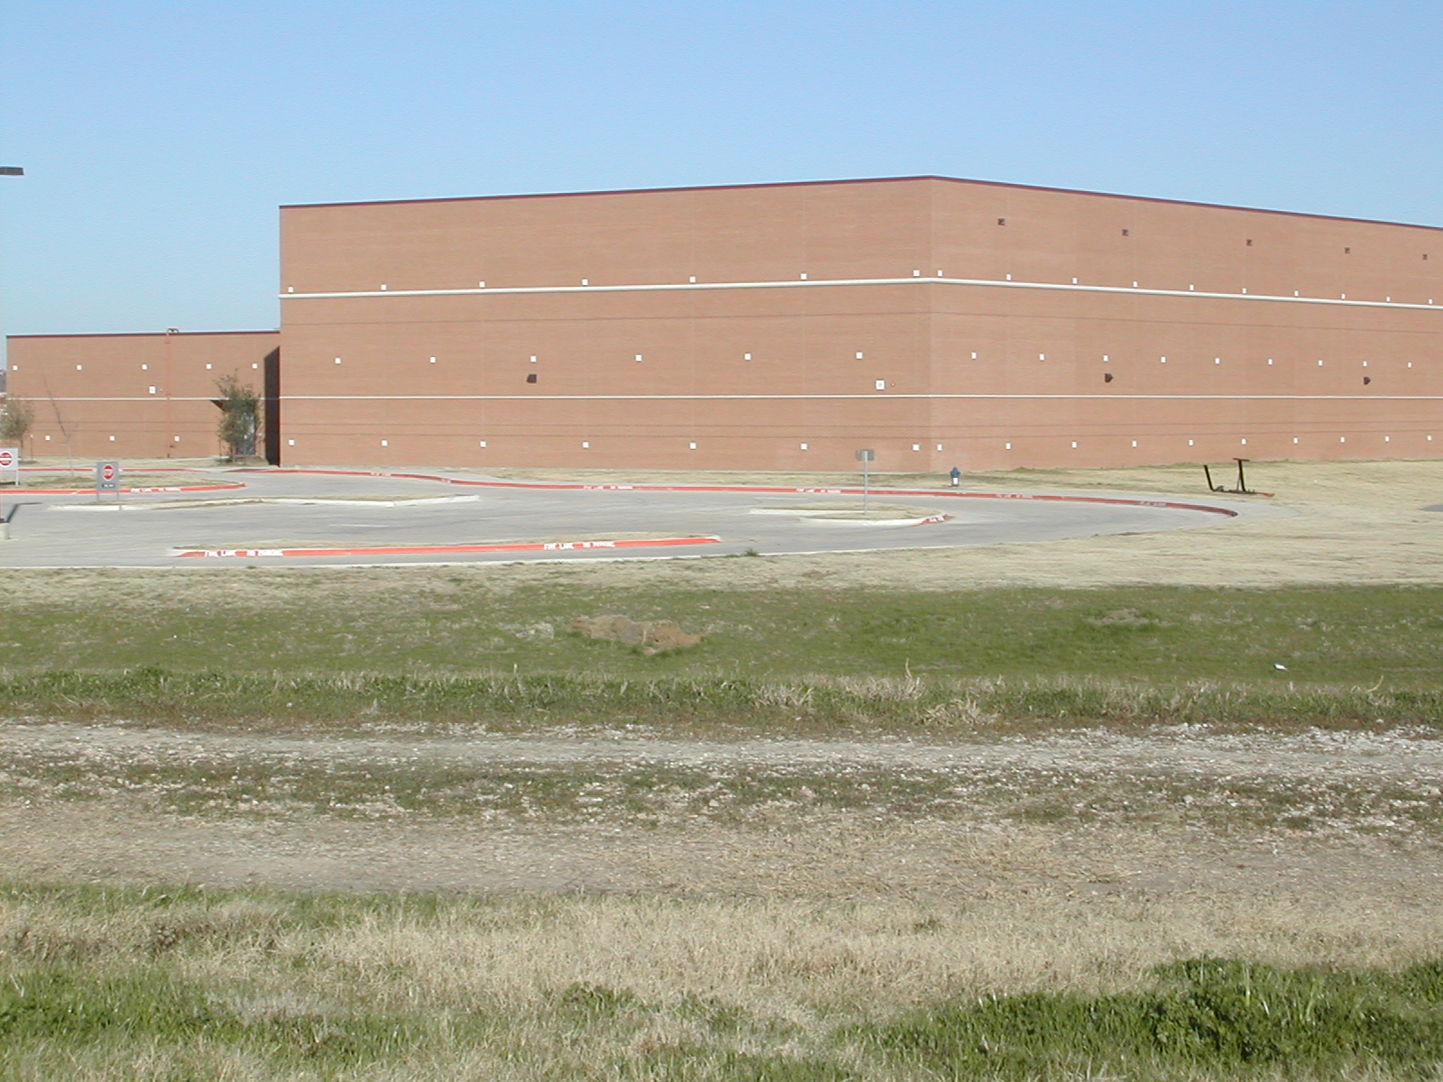
Got Windows?
Notes:
(Picture of building without windows)
This is quite effective for blocking out the “distractions” of the world around us.

Slide 41
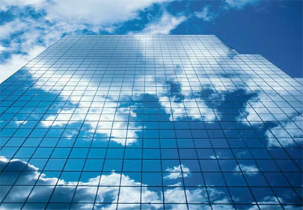
What are Highly Glazed Facades?
Highly glazed facades offer transparency, access to daylight and a connection to the outside, however they also present additional challenges.
Notes:
Highly glazed office buildings offer transparency, access to daylight, and a sense of connection between indoor and outdoor environment, which is superior to that provided by conventional buildings where windows typically make up approximately 30 % of the external wall area.

Slide 42

Pros & Cons of Glazing
+ Better exposure to views
+ Greater transmission of natural light
- High potential to solar gain and glare, both indirect and direct
- Increases the need for solar protection and integration
Notes:
However fully glazed facades can be a great challenge in terms of combining energy consumption with thermal comfort. In buildings with highly glazed facades which are exposed to direct and reflected solar radiation it is also a challenge to secure the visual comfort of the occupants. The use of movable solar shading is an essential way of facilitating visual comfort in highly glazed buildings.

Slide 43

Why is Natural Ventilation Important?
Combat the symptoms of Sick Building Syndrome
Lower incidence of sickness due to the presence of recycled air
Reduces the need for air conditioning
Notes:
Unlike climate-responsive architecture in cold and temperate regions, hot climates need to avoid solar heat gain. Two complementary approaches to limiting increases in temperature exist. The first consists of shading living areas from solar radiation. The second implements airflows to release internal hear gains as well as solar ones.
Outflows of air enable the release of heat from a building caused by electrical equipment, lighting, and its occupants. Achieving comfortable levels of temperature, humidity, and wind velocity are three physical factors towards feeling cool. There are different approaches when evaluating the potential site with regard to ventilation. 1) facing facades into the prevailing wind during the hottest months 2) Placing the structure at a distance from obstacles to air flow 3) shading the for of the envelope of the structure from solar radiation 4) sizing apertures and systems to promote the outflow of air from inside the building 5) planning the interior layout such that air circulation is handled with minimum friction.
In hot and dry climates it is also possible to humidify and cool the air through evapotranspiration or exploit overnight cooling thanks to a building’s inertia.

Slide 44
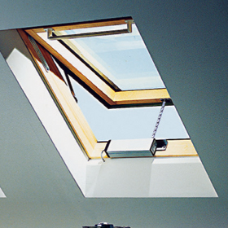
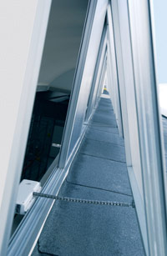
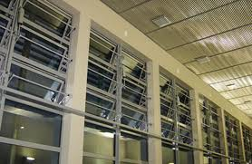
Types of Ventilation
Notes:
Double skin facades offer a greater variety of options for ventilation. Naturally ventilated facades can be closed off during the heating season to increase the thermal insulation, or opened in cooling mod allowing natural ventilation for heat extraction. Mechanically ventilated double skin facades can use the cavity to preheat fresh air supplied to the air handling unit, and when in cooling mode, the outdoor air is mechanically extracted through the cavity. Hybrid ventilation combins both natural and mechanical elements to augment the overall ventilation process. Airflow windows allow the air to enter the cavity from indoors as exhaust air, the movement of which controls the indoor glass surface temperatures for extreme winter and summer conditions.

Slide 45

Benefits of Natural Ventilation *
Higher levels of oxygen in fresh vs indoor air
Oxygen levels impact worker performance and health
Increases mental clarity
Strengthens immune system
Increases metabolism
* REHVA Guidebook 2010
Notes:
Indoor air quality is a topic of concern for health authorities and one of the criteria of a high-quality environment. Many pollutants are effectively concentrated in the air indoors, coming simultaneously from our activities, the products we use, and from building materials. The primary source of pollution is still carbon monoxide, followed by carbon dioxide, animal allergens, mites, mildew, volatile organic compounds and artificial mineral fibers.

Slide 46
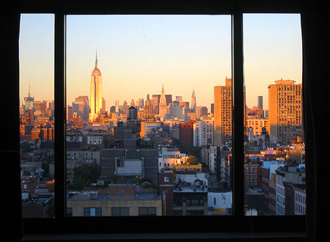
Window views reduce major health
complaints by
25%
REHVA Guidebook 2010

Slide 47
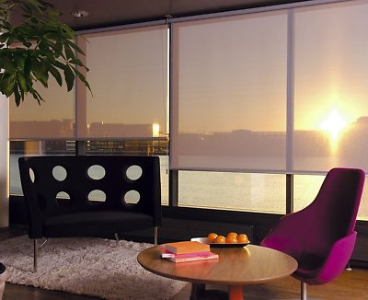
Solar Shading
Objectives
Safety
Analysis
Impact
Automated Shading
Notes:
One of the fundamental concepts of bioclimatic architecture in warm climates is to shade windows from the sun’s rays. Insulating materials, reflective coatings and shade screens represent different types of shading systems. The graph shows solar factor which is the relative solar gain through protected by shutters and blinds as opposed to windows with no coverings. Most effective are wooden shutters which allow 9% to 10% of the solar gain. External cloth awnings range from 7% to 19% depending upon material. Internal cloth awnings range from 34% to 59%. External Venetians have a factor of 11% to 13% while internally they range from 45% to 65%.

Slide 48
Objectives of Solar Shading
Reduce Glare
Control Temperature
Eliminate Direct Exposure
Increase Insulation
Ensure Occupant’s Privacy
Prevent Fading
Aesthetic
Notes:
Solar shading can used to attain several objectives as shown in the illustration on the left hand side. Reducing glare, reducing overheating, eliminating directinsolation, increasing a window’s insulation properties, ensuring an occupant’s privacy or closing off a room, prevent fading of certain fabrics, and decorating windows. On the right hand side there is a graph of suggested shading options based on orientation, going over fixed solar screens, movable exterior, movable interior, or no protection required.

Slide 49
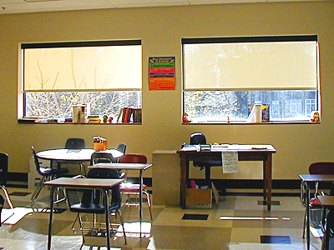
Safety
Automated shades eliminate
the need for cords

Slide 50
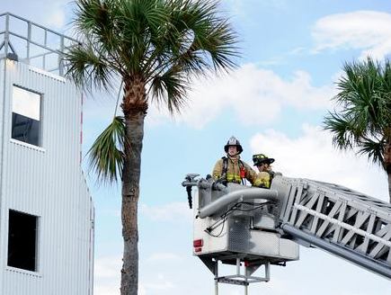
Safety
Automated shades can provide instant access to windows in emergency situations
Notes:
50
The diagrams show you the sun’s path (yellow line) through the sky in relation to a single day and a full year time.
50

Slide 51
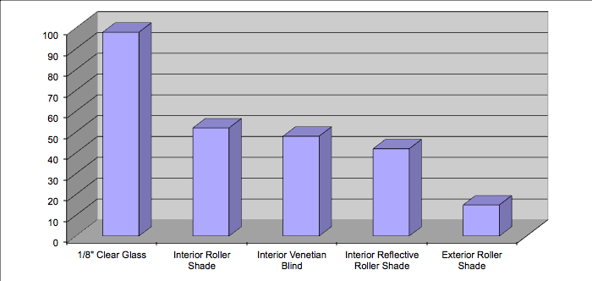
Shading Analysis
Notes:
1/8” clear glass is the baseline standard with a SC of 1.0 or 100% of the solar energy is passed through the opening. Interior products usually have a relative SC of 0.60 – 0.55 therefore 40 – 45% of the energy still passes into the space. For example 300 watts per square meter hitting a surface with a 0.55 SC has 165 W/m2 of energy still passing into the space (300 X 0.55 = 165) or a 45% reduction. Exterior products obviously provide far better performance as they block most of the energy before hitting the glass.

Slide 52
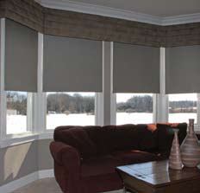
Impact of Solar Shading?

Slide 53
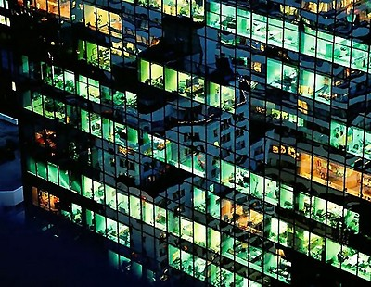
Aesthetics
Automated shading provides controlled consistency of external aesthetics at night.
Natural Daylight affects the quality of colors placed in a room by hitting them with the full color spectrum.
Notes:
53
The sun angle increases as we move closer to the equator. In Miami the angle of the sun on June 21st (Solar Apex) reaches 84 degrees or almost completely vertical.
53

Slide 54

Why Automated Solar Shades?
Optimization of solar and thermal control
Ensures operation of shade as required
Maximizes the light to solar heat gain ratio
Automatic light and glare control
Eliminates cords

Slide 55

Industry studies
have shown that
manual shades are only moved
once or twice a day,
if at all...

Slide 56

Benefits of Automated Shading
Increases mental function
Optimizes overall comfort
Increase occupants wellbeing
Automatically manages glare
UV protection
Aesthetics
Greatly increases energy savings
Increases Productivity
Decreases Sick Building Syndrome
Contributes to indoor air quality
Acoustics
Optimizes visual comfort
Reduces absenteeism

Slide 57


Questions?
This concludes the AIA Continuing Education Systems Program

